Slide 1
Love Wins:
Trauma, the Nervous System and Recovery
James Seymour, MD, SEP
Director, Program for Trauma Recovery
Diplomate American Board of Neurology and Psychiatry
Diplomate American Board of Addiction Medicine

Slide 2
Notes:
It seems there are therapists all over trying to help one at a time. Group Shot

Slide 3
Qualifications and Experience
Director, Program for Trauma Recovery at Sierra Tucson
Board Certified in psychiatry as well as addiction medicine
35 years experience as a psychiatrist, working in a variety of settings including inpatient, outpatient, medical hospital consultation, rehabilitation hospitals, adult care homes, home visits, ECT, public and private settings, Indian Health Service and residential treatment programs

Slide 4
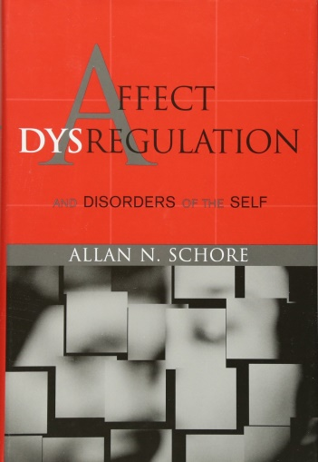
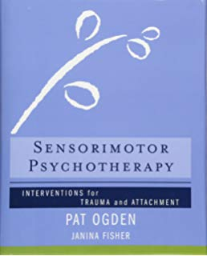
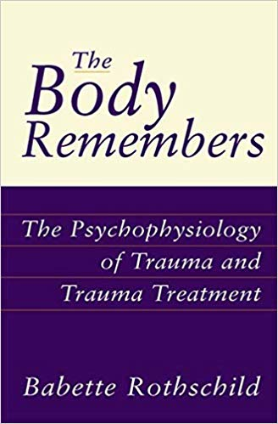
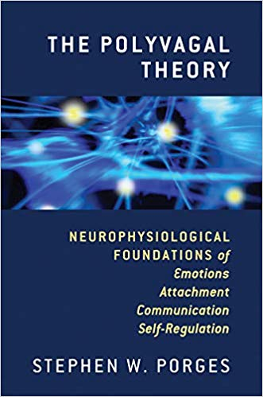
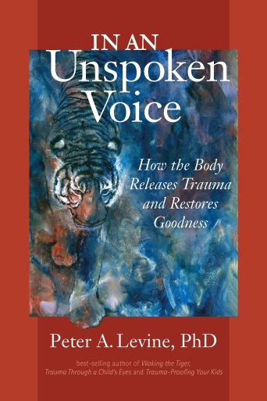
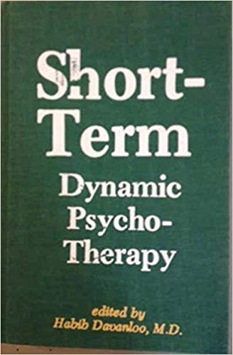
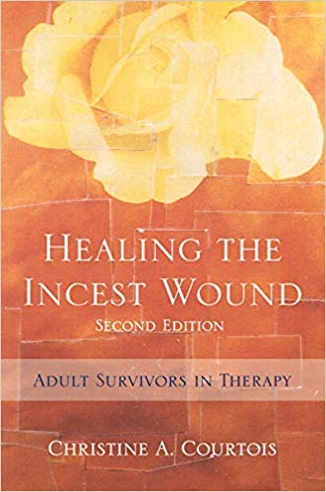
Sources and Inspiration
Stephen Porges
Allan Schore
Peter Levine
Pat Ogden
Babette Rothschild
Janina Fisher
Kathy Steele
Christine Courtois
Diana Fosha
Habib Davanloo

Slide 5
Areas to Cover
New Perspectives
The polyvagal theory
Implications for clinical practice
Somatic Therapies
Principles
Demonstration

Slide 6
February 14, 2008

Slide 7
New Perspectives
We should no longer talk about post traumatic stress disorder.
It gets rid of stigma.
It emphasizes that there is nothing essentially wrong with the person.
It makes it possible to focus more on strengths and resources rather than psychopathology.
Post traumatic stress disorder is not a disorder but a normal adaptation and response of the nervous system to psychological trauma.

Slide 8
New Perspectives
It gets rid of stigma
It is more in line with what we know about neurobiology
It is hopeful and implies capacity to change by learning new coping mechanisms as well as by better nervous system regulation.
We should no longer talk about Borderline Personality Disorder.
Rather we should talk about maladaptive coping mechanisms to deal with a dysregulated nervous system often secondary to psychological trauma.

Slide 9
New Perspectives
Categorical diagnoses have generally outlived their usefulness as a concept or construct to describe emotions and behavior
They are arbitrary categories based upon signs and symptoms and do not reflect the commonality of nervous system dysregulation
They fit the person into a box
They do not reflect what we know about neurobiology but rather are voted on by committees
DSM -IV-TR NOS and DSM 5 Unspecified are common diagnoses

Slide 10
New Perspectives
We no not “treat trauma”
The individual has already survived the trauma
The effects of psychological trauma are not a disease we need to treat
What we are doing is assisting and facilitating recovery from the effects of trauma
Language makes a difference

Slide 11
New Perspectives
Regulation theory provides a more concise, more elegant, and simpler explanation of complex emotional and behavioral difficulties than does categorical diagnosis
Regulation theory is completely compatible with what we know about neurobiology, attachment, evolution, and the development of the nervous system
The polyvgal theory links the development of the autonomic nervous system over time to complex human behavior

Slide 12
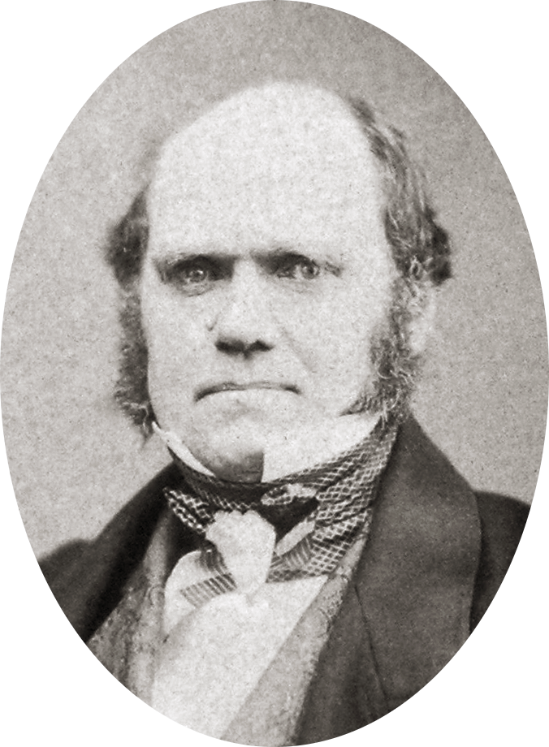
The Polyvagal Theory

Slide 13
The Polyvagal Theory
There are two distinct vagal nervous systems in mammals
Neuroregulation of the heart is anatomically and functionally linked to the neural control of the muscles of the face and head
The vagus nerve complex mediates the social engagement system

Slide 14
The Polyvagal Theory
“The polyvagal theory links the evolution of the neural regulation of the heart to affective experience, emotional expression, facial gestures, vocal communication and social behavior that is responsive to the behavior of others”
~ Stephen Porges

Slide 15
The Vagus Nerves
Basically is the parasympathetic system
Cranial nerves originating in the brainstem (medulla)
The second longest nerves in the human body
The “innards”
Rest and digest
80% of fibers are afferent

Slide 16
The Vagus Nerves
Two vagal pathways
Myelinated
(in mammals)
Unmyelinated
(older)

Slide 17
Originating Nuclei
Dorsal motor nucleus of the vagus – unmyelinated
Nucleus ambiguus – myelinated, ventral vagal complex (VVC)
Also includes cranial nerves IX and XI
hypoglossal ( tongue) and accessory (neck)

Slide 18
Ventral Vagal Complex
Special visceral efferents – face and head
Derived from the branchial arches ( gills )
Cranial nerves V, VII,IX,X, and XI
Chewing, sucking, swallowing, vocalizations, facial expressions, listening, guts, heart, lungs , and head turning
The ventral vagal complex is the social engagement system

Slide 19
Approach – Avoidance
Special visceral efferents – face and head
Derived from the branchial arches ( gills )
Cranial nerves V, VII,IX,X, and XI
Chewing, sucking, swallowing, vocalizations, facial expressions, listening, guts, heart, lungs , and head turning
The ventral vagal complex is the social engagement system

Slide 20
Immobilization
Unmyelinated fibers from the dorsal motor nucleus of the vagus
Behavioral shutdown
Conservation of Energy
Freeze reaction
Imminent death
Dissociation

Slide 21
Mobilization
Sympathetic nervous system
Spinal cord
Increased metabolic activity
Action
Fight or flight and the hypothalamic – pituitary adrenal hormonal cascade

Slide 22
Social Engagement System
Ventral Vagal Complex
Myelinated fibers
Regulation of the heart linked to control of the muscles of the head and neck
Vagal “brake”

Slide 23
Vagal Brake
Myelinated fibers from the ventral vagal complex
Chronic vagal tone
Inhibits normal firing rate of the heart
Release allows intermediate state between relaxed awareness and the full sympathetic nervous system cascade

Slide 24
Vagal Brake
Fluid movement of the vagal brake allows and fosters effective social engagement
Reciprocal – social engagement of one another increases vagal tone
Attachment increases vagal tone
Operates in a setting of relative safety
Not an all or none phenomena – graded inhibition of the cardiac pacemaker

Slide 25
Respiratory Sinus Arrhythmia (RSA)
The respiratory sinus arrhythmia can be used as a measurement of the fluidity of the vagal brake non-invasively
The increase and decrease of the heart rate associated with the breathing cycle
A naturally occurring rhythm
A higher baseline RSA and the amplitude of the movement under stress means higher vagal tone and smoother functioning of the data brake.

Slide 26
Some Data
Infant study
“Borderline” study
Women with abuse histories
Yoga
Notes:
Stephen porges study – non respiratory way – did infant study. Associated with behavioral problems at age 3
Borderline study – same baseline RSAs as controls – longer one is in the presence of someone else the RSA increases….good health with borderlines RSA decreases and creates stress – approach avoidance… “I hate you but don’t leave me.” Connection causes anxiety.
Women with abuse histories – no PTSD diagnosis; stress = low RSA and longer time to recover…Yoga classes made them improve.

Slide 27
Vagal Brake and Dissociation
Immobilization response associated with the subjective sense of dissociation
Lower RSA ( decrease in vagal brake) increases the likelihood of activating the immobilization response from the unmyelinated fibers from the dorsal motor nucleus.
Immobilization response associated with the subjective sense of dissociation

Slide 28
Traumatic Environment
Decreased flexibility of the vagal brake
Less limbic and cortical modulation of the brainstem
Decreased opportunity for the development of and the fluid functioning of the social engagement system
Impaired capacity to be soothed by others

Slide 29
Clinical Implications
The goal of assisted facilitation of recovery from the effects of psychological trauma is to improve functioning and increase the quality of life and adaptive coping behavior
The therapeutic interventions most likely to help achieve those goals are “any that engage , recruit, utilize, and expand the capacity of the social engagement system”.
Stephen Porges

Slide 30
Clinical Implications
Engage the autonomic nervous system directly when possible
The limbic and cortical changes that follow expanding the capacity of the social engagement system is effective across all diagnostic categories
In trauma recovery, face to face verbal interactions in an office setting often can mobilize the sympathetic nervous system which is a defensive system rather than the social engagement system.

Slide 31
Consistent Findings
Music, not the lyrics
The quality of the therapeutic relationship is the most important factor in assisted healing
Positive regard for the client
Joint expectation that the client will get well
Client feedback
Attachment disruption and repair foster regulation capacities
“I am sorry.” “ I should not have said that.” “I should not have used that tone of voice.” “I misunderstood.”

Slide 32
Consistent Findings
A common feature of successful trauma “treatment” is the pendulation from a parasympathetic predominant state to a moderate rise in the sympathetic activation (staying within the window of tolerance) followed by a return to a parasympathetic resting state
A common problem of those working with effects of psychological trauma is to start the technique when the sympathetic system is more active than the parasympathetic system ( not in ventral vagal) and increasing the sympathetic stimulation past the window of tolerance and not allowing the parasympathetic pendulation to complete.

Slide 33
How do you know if you have made a mistake in addressing the autonomic nervous system?
Clinical Implications
The client feels worse after the session
Functioning goes down between sessions

Slide 34
Modalities
Breathing Exercises
Mindfulness
Distress management skills
Grounding
Equine
Dance and movement
Yoga

Slide 35
Modalities
Music
Group support and therapy
Games
Touch
Drumming
Art
EMDR
Somatic Experiencing
Sensorimotor psychotherapy

Slide 36
Modalities
Craniosacral
Somato emotional Release
Shiatsu
Acupuncture
Reiki
Zero Balancing
Martial arts

Slide 37
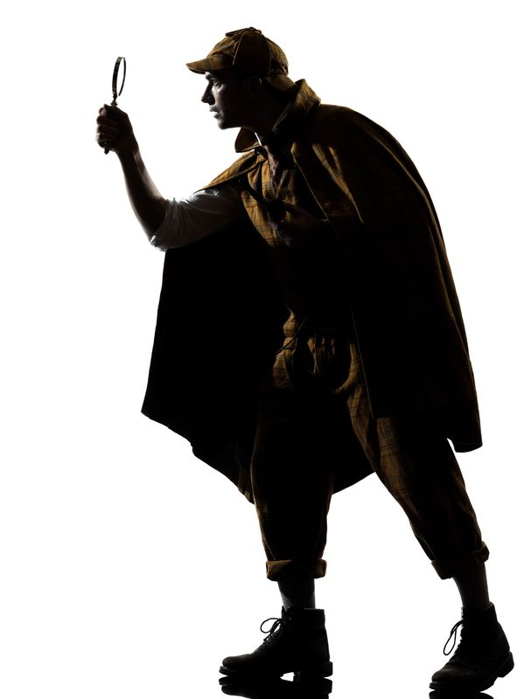
Bottom Up Processing
Trees to the forest
Inductive reasoning
“small chunk” processing
Regulating the autonomic nervous system alters the limbic system and cortical structures resulting in emotional and behavioral change

Slide 38
SE and Sensorimotor Psychotherapy
Bottom up processing
Somatic mindfulness
The narrative is in the body (implicit memory)
Can be done without knowing the full verbal story
Does not require repetition of traumatic events
Focus on expanding the capacity of the ventral vagal system
Titration and the window of tolerance

Slide 39
Examples
The fearful man
The alexithymic man
The chronically depressed woman
The demeaned woman
The heart attack woman
The lioness and completion of the fight impulse

Slide 40
Principles
“A healer does not heal you. A healer is someone who holds space for you while you awaken your inner healer, so that you may heal yourself.”
~ Maryam Hasnaa

Slide 41
Ten Rules for Trauma Therapists (from Babette Rothschild)
Principles
Establish safety for the client both within and outside of therapy
Develop good contact between therapist and client as a prerequisite to addressing trauma memories or applying any techniques, even if this takes months or years.
Both therapist and client must be confident of applying the brake before they apply the accelerator

Slide 42
Ten Rules for Trauma Therapists (from Babette Rothschild)
Principles
Identify and build on internal and external resources
Regard defenses as resources. Never get rid of defenses or coping strategies, create more choices.
View the trauma system as a pressure cooker. Always work to reduce, never increase the pressure.
Adapt the theory to the client rather than expecting the client to adapt to the therapy

Slide 43
Ten Rules for Trauma Therapists (from Babette Rothschild)
Principles
Have a broad knowledge of theory – both psychology and physiology of trauma and PTSD
Regard the client with his/her individual differences and no not judge for noncompliance or the failure of an intervention. Never expect one intervention to have the same results on two clients
The therapist must be prepared at times, or even for a whole course of therapy to put aside techniques and just talk with the client.

Slide 44
Principles
“The best thing we can offer our clients is ourselves”
~ Babbette Rothschild
“Be present”
~ James Seymour

Slide 45
My Principles
Since the best thing we can give the client is ourselves we must be healthy and well regulated
Seek therapy for yourself often throughout your career
Love heals – we must be connected to love through our spirituality, our relationships, and love for ourselves
Let’s take the shame hat off and put our curiosity caps on

Slide 46
My Principles
Connect the client with love, light, goodness, wellness, joy, strengths, resources, and their spirituality
Spirituality includes those things that make us feel present, like we belong, that give us the sense of being alive here, right now.

Slide 47
Excerpt from “Sitting With The Shattered Soul”
“So how do you sit with a shattered soul? Gently, with gracious and deep respect. Patiently, for time sits still for the shattered and the momentum of healing will be slow at first. With tender strength that comes from openness to your own deepest wounding, and to your own deepest healing. Firmly, never waver in the utmost conviction that evil is powerful; but there is good that is more powerful still. Stay connected to that Goodness with all your being; however it manifests itself to you.”
~ Kathy Steele

Slide 48
References
Cloitre, M., Courtois, CA.,Ford, J.D.,Green, B.L., Alexander,T., Briere, J., Herman, J.L., Vanderkolk, B.A., Van der Hart,O., (2012) The ISSTS Consensus Treatment Guidelines for Complex PTSD in Adults. Retreived from http:www.issts.org
Emerson, David. Harper, Elizabeth. (2011) Overcoming Trauma Through Yoga: Reclaiming Your Body. Berkley, California: North Atlantic Books
Vander Kolk, Bessel, A., McFarlane, Alexander.,Weisaeth, Lars., (Eds) (2011) Trauma and Stress: The Effects of overwhelming experiences on Mind, Body, and Society. New York, New York: The Guilford Press
Ogden, P., Minton, K., Pain, C.(2006) Trauma and the Body: A Sensorimotor Approach to Psychoththerapy). North Atlantic Books. New York, New York: W.W. Norton& Company
Levine, P. (2010) In an Unspoken Voice: How the Body Releases Trauma and Restores Goodness. Berkley, California: North Atlantic Books. Berkley, California

Slide 49
References
Porges, Stephen W. (2011) The Polyvagal Theory: The Neurophysiological Foundations of Emotions, Attachment, Communication, Self Regulation. New York, New York: W.W. Norton & Company
Schore, Allan N.,(2003) Affect Dysregulation and Disorders of the Self. New York, New York: W.W. Norton & Company
Courtois, Christine A., (2010) Healing the Incest Wound Second Edition: Adult Survivors in Therapy. New York, New York: W.W. Norton & Company
Rothschild, Babette. (2000) The Body Remembers: The Psychophysiology of Trauma and Trauma Treatment. New York, New York: W.W. Norton & Company

Slide 50
Questions?
James.Seymour@SierraTucson.com
James Seymour, MD, SEP
Director, Program for Trauma Recovery
Diplomate American Board of Neurology and Psychiatry
Diplomate American Board of Addiction Medicine

Slide 51
Thank you
James.Seymour@SierraTucson.com
James Seymour, MD, SEP
Director, Program for Trauma Recovery
Diplomate American Board of Neurology and Psychiatry
Diplomate American Board of Addiction Medicine

